Slide 1
Farm to School
Primary Vendor NJ Farm Partnerships
Regional Produce Vendor NJ
Farm Partnerships
Local Micropurchase NJ Farms

Slide 2
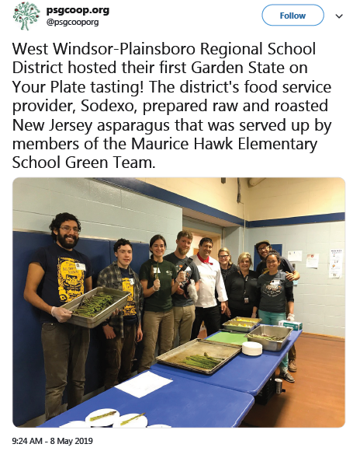
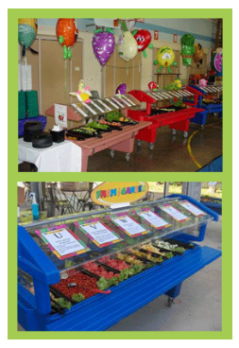
Farm to School Promotions

